Slide 1
Sociology of health and medicine 1
Xuewen Yan

Slide 2
Why is sociological about health and medicine?
Sociological imagination: We take something that seems biological, our health, and show how is it shaped in important ways by social structure and culture

Slide 3
Common measures of health (socially complicated!)
“Health is a state of complete physical, mental, and social wellbeing and not merely the absence of disease or infirmity” – World Health Organization (1948)
Illness vs disease
Disease (“the biological condition”; abnormalities in the structure and function of bodily organs and systems)
Illness (“the social meaning of the symptoms and conditions”; patient’s experience of a bodily condition)
Death/mortality
Clinical death: The cessation of heartbeat and respiration; resuscitative efforts begin
Brain death: Electrical activity in brain stops: often occurs 4-6 minutes after clinical death (EEG is a line)
Social death: The moment a person is acted upon as dead (can be regardless of clinical viability
Access to health care
Mental health (suicide)
Genetic disposition, social experience (personal experience, buffering)

Slide 4
Health and inequality
This is where the bulk of mainstream health research in sociology lies. Mostly quantitative, sometimes in collaboration with physicians.
Main idea: Social determinants of health➔ group-level (sociodemographic, regional, and temporal) patterns of different health outcomes
SES gradient in health:
link between education and smoking
Self-selection?
“fundamental causality” (Lutfey and Freese 2005)
Different pathways to health all go through SES
SES not merely a “placeholder” but a “fundamental cause” that generate the causes for illnesses
Economic fluctuations and health: “Good times make you sick” (Ruhm 2003).
Historical trends of country-level variations in life expectancy
Public welfare policy as an important solution
Austerity vs social support in Iceland in the great economic recession.

Slide 5
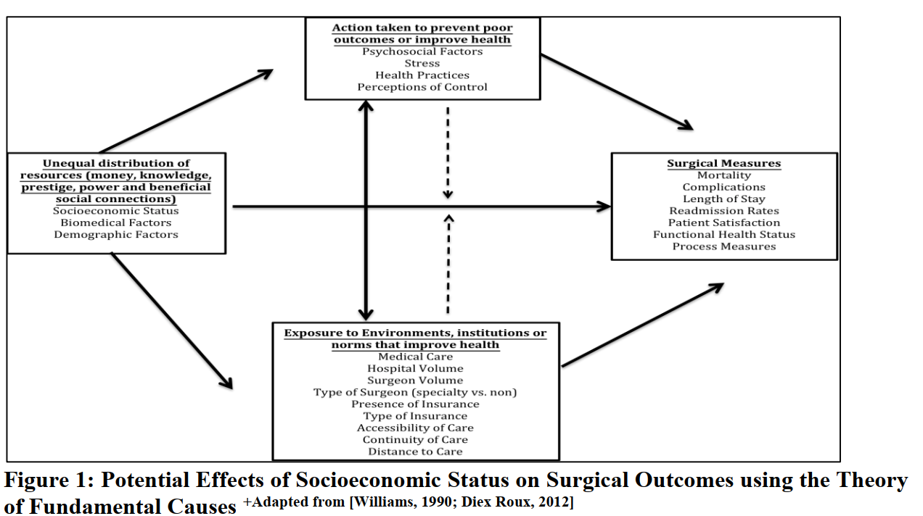
SES gradient in health - SES: fundamental cause of health

Slide 6
Key social determinants of Health in China
SES measured as subjective social class

Slide 7
Key social determinants of Health in China
SES measured as Education
Key social determinants of Health in China
Key social determinants of Health in China

Slide 8
Key social determinants of Health in China
SES measured as Income

Slide 9
Key social determinants of Health in China
Rural/urban divide

Slide 10
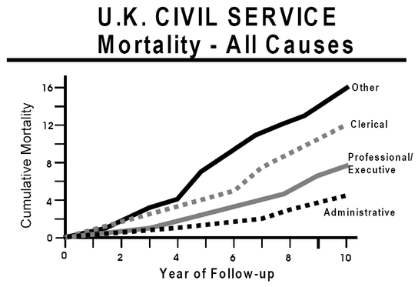
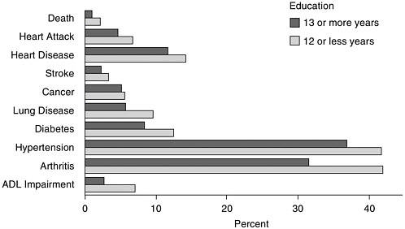
SES gradient in health
Death within 2 years and prevalence of various conditions, by years of education (in percent).
NOTE: ADL, activities of daily life.
SOURCE: Data from Health and Retirement Survey, as reported by Crimmins et al. (2004).

Slide 11
A little bit of demography: “Sociodemogrpahic” also includes demographic variables
Gender differentials in health:
Longer life expectancy of women, more morbidities and illness among women
Racial differences in health
Higher mortality rates among blacks than whites
Healthier Hispanic than whites (self-selection of immigration? Not all of it…)
Marital differences in health
Higher life expectancy of the married
Higher risk of mortality immediately (2 years) after widowhood
Women gains less from marriage than men
Basic concepts about mortality rates
Morality rates: raw vs age-adjusted vs age-specific

Slide 12
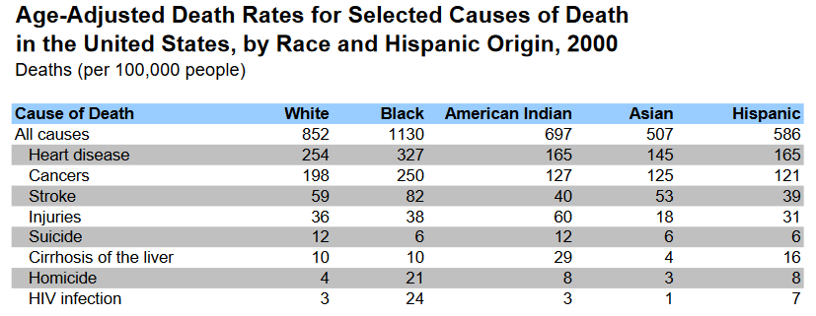
Racial differences in mortality rates in the US (1)

Slide 13
Racial differences in mortality rates in the US (2)
https://www.cdc.gov/nchs/data-visualization/mortality-trends/index.htm

Slide 14
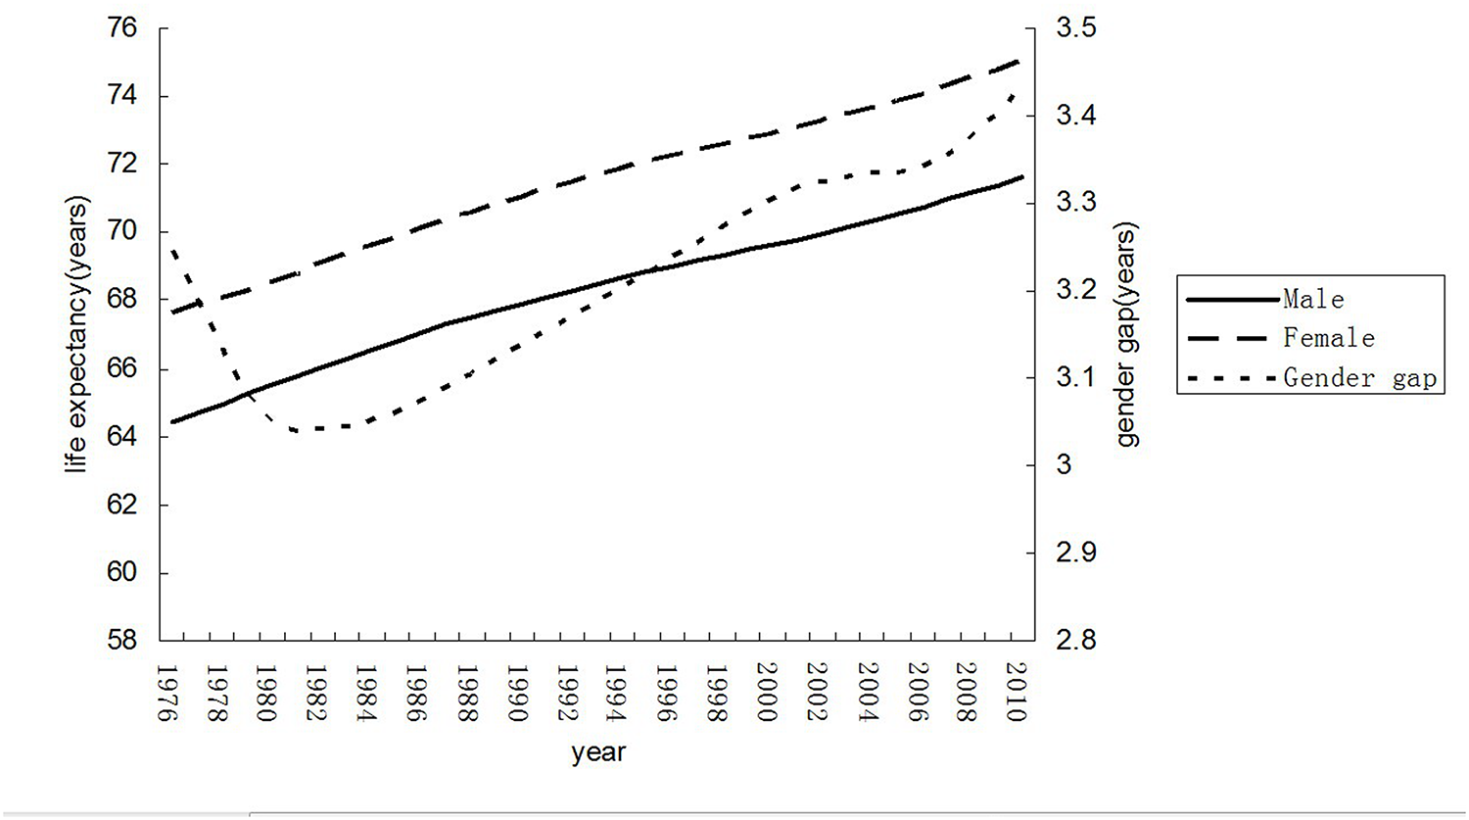
Gender Differences in Life Expectancy in Chinese Cities
Le, Yan, Jie Ren, Jie Shen, Tong Li, and Cheng-Feng Zhang (2015).

Slide 15
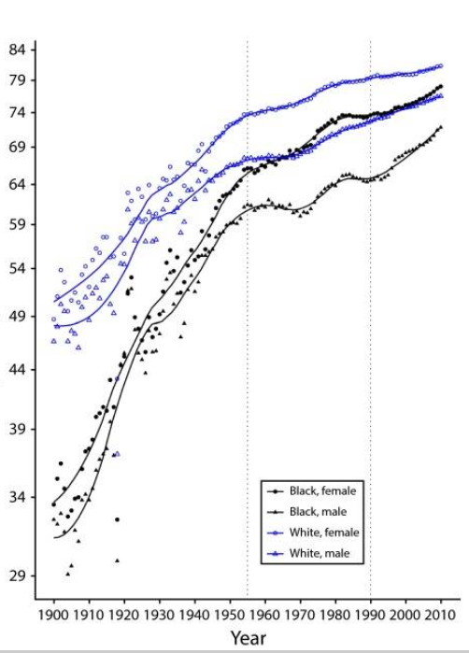
Life expectancy by gender and sex in the US
2022.05.03

Slide 16
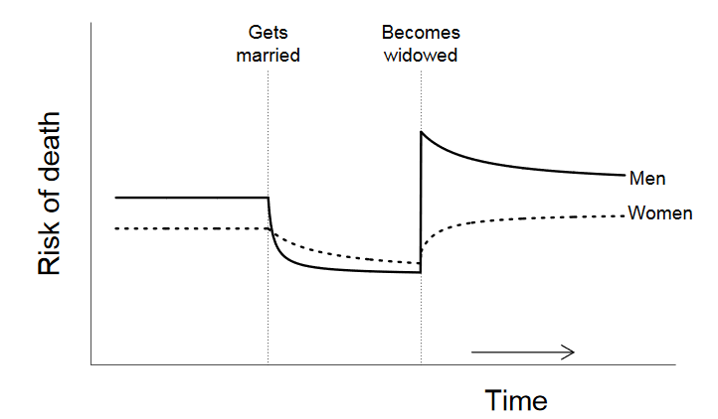
The groom gains more from marriage?
On average, being married adds 7 yearsto a man’s life and 2 to a woman’s
Widowhood effect: dying of a broken heart

Slide 17
Further readings
Lutfey, Karen, and Jeremy Freese. "Toward some fundamentals of fundamental causality: Socioeconomic status and health in the routine clinic visit for diabetes." American Journal of Sociology 110, no. 5 (2005): 1326-1372.
Stuckler, David, Sanjay Basu, Marc Suhrcke, Adam Coutts, and Martin McKee. "The public health effect of economic crises and alternative policy responses in Europe: an empirical analysis." The Lancet 374, no. 9686 (2009): 315-323.
Le, Yan, Jie Ren, Jie Shen, Tong Li, and Cheng-Feng Zhang. "The changing gender differences in life expectancy in Chinese cities 2005-2010." PloS one 10, no. 4 (2015): e0123320.
Martin, Emily. "The egg and the sperm: How science has constructed a romance based on stereotypical male-female roles." Signs: Journal of Women in Culture and Society 16, no. 3 (1991): 485-501.
The health advantages of marriage, Harvard Health Blog, https://www.health.harvard.edu/blog/the-health-advantages-of-marriage-2016113010667
Ruhm, Christopher J. "Good times make you sick." Journal of health economics 22, no. 4 (2003): 637-658.
Fadiman, Anne. The spirit catches you and you fall down: A Hmong child, her American doctors, and the collision of two cultures. Macmillan, 2012.

